Slide 1
Introduction to Distributed Systems

Slide 2
Contents at a glance
Tightly Coupled vs Loosely Coupled System
Multiple CPU Systems
Definition of Distributed system
Goals of Distributed Systems
Examples of Distributed Systems
Reasons for Distributed Systems
Advantages of distributed systems over centralized systems

Slide 3
1. Tightly Coupled vs Loosely Coupled System
Parallel and Distributed systems
Tightly
coupled
Loosely
coupled
Multiprocessors
(Shared memory)
Multicomputers
(Private memory)
Bus
Switched
Bus
Switched

Slide 4
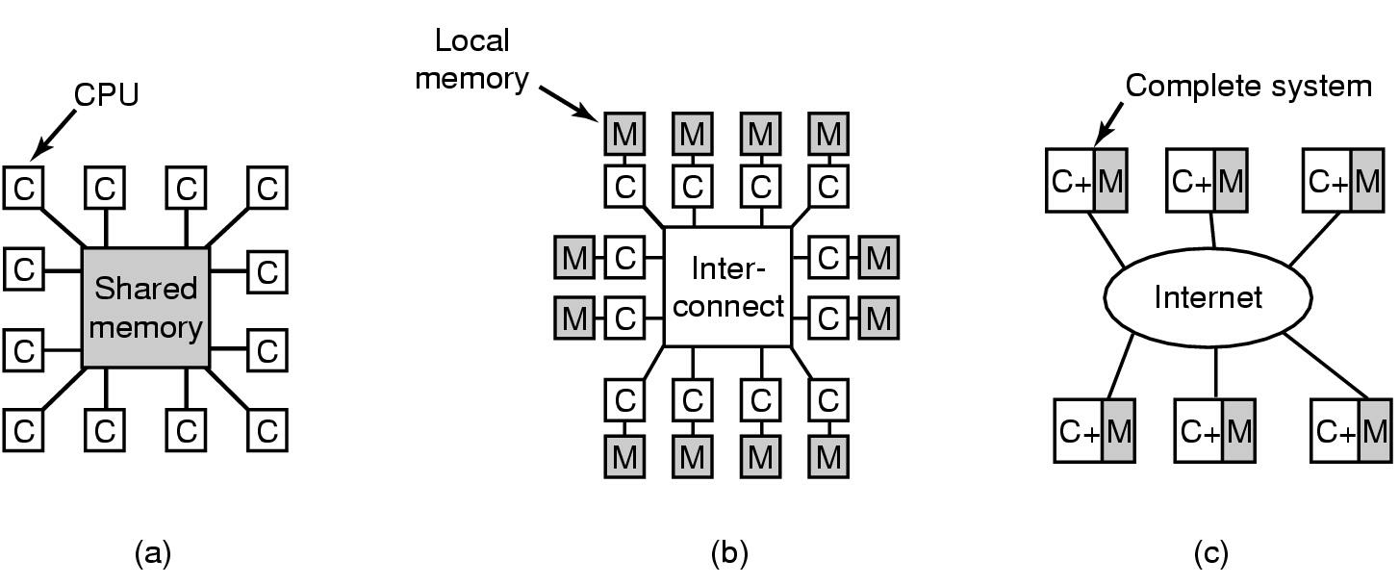
2. Multiple CPU Systems
Continuous need for faster computers
  shared memory model
  message passing multiprocessor
  wide area distributed system

Slide 5
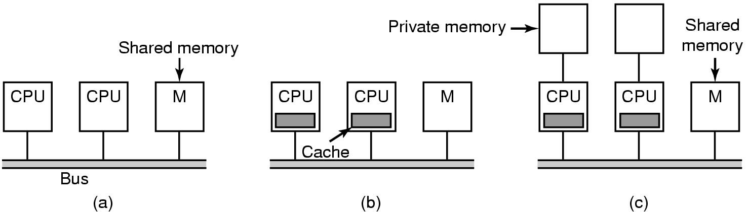
2.1 Multiprocessors
Definition:
A computer system in which two or more CPUs share full access to a common RAM.

Slide 6
2.2 Multi-Computers
Definition
Tightly-coupled CPUs that do not share memory
Also known as
  cluster computers
  clusters of workstations (COWs)

Slide 7
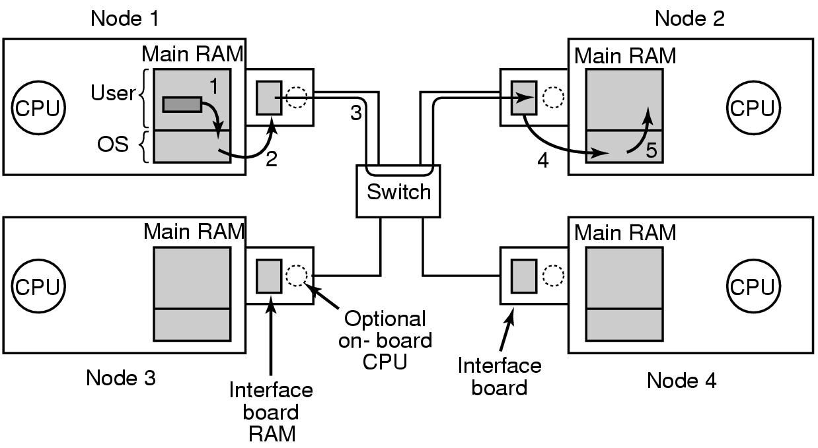
2.2 Multi-Computer Hardware
Network interface boards in a Multicomputer

Slide 8
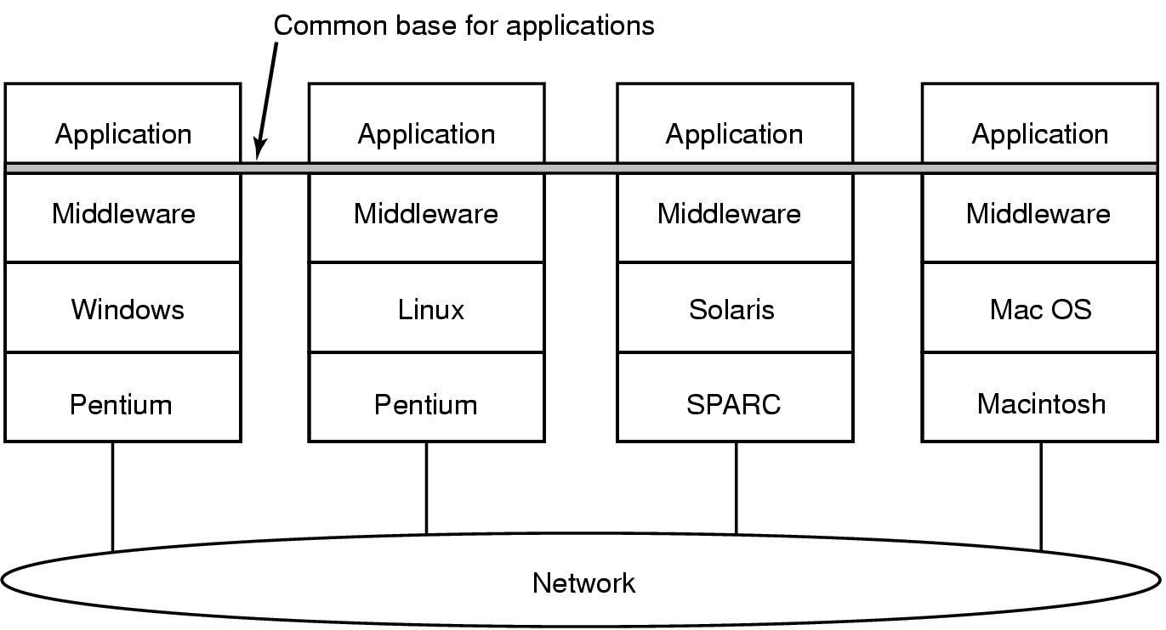
Distributed Systems
2.3 Distributed Systems
Achieving uniformity with middleware

Slide 9
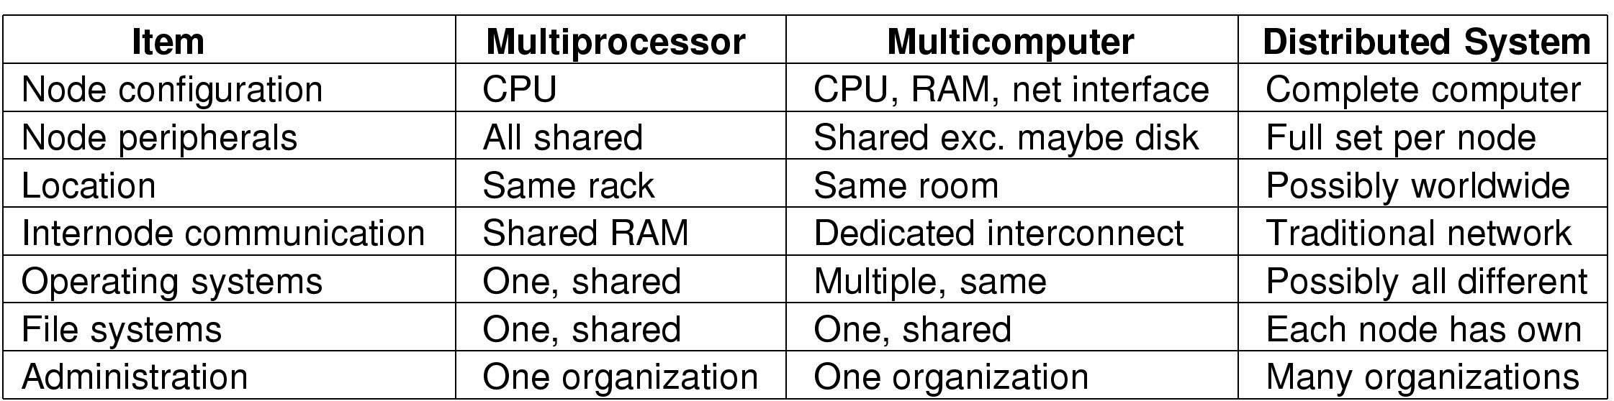
2.4 Comparison of Multiple CPU Systems
Comparison of three kinds of multiple CPU systems

Slide 10
3.0 Distributed System
Andrew Tanenbaum
  A collection of independent computers that appear to the users as a single coherent system.
Leslie Lamport
  You know you have a distributed system when the crash of a computer you’ve never heard of stops you from getting any work done.

Slide 11
4.0 Goals of Distributed system
The main goal of the distributed system is
To make the existence of multiple computers invisible and provide a single system image to its users.
Thus a distributed must be designed in a such way that a collection of distinct machines connected by a communication subsystem appears to its users as a virtual uni-processor.

Slide 12
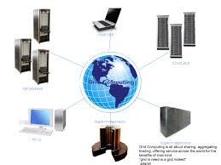
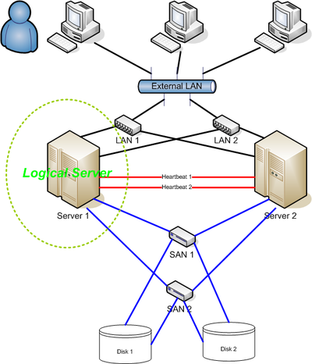
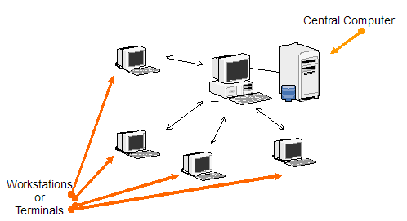
4.0 Goals of Distributed Systems
Connecting Users and Resources
Transparency
Openness
Scalability
Enhanced Availability
Notes:
Connecting users: Ultimately we want out system made widely avail.
Transperency: User should be unaware of complexity behind system, access it almost like local system.
Openness: Use standards (like http/ftp, w3 standards) so anyone can interface with, understand and extend your system
Scalability: Having near linear scaling is the ultimate goal, add capacity to deal with growth

Slide 13
5.0 Examples of Distributed Systems
Distributed Multimedia Systems
  Teleconferencing
  Distance learning
IP Telephony
Flight management system in an aircraft
Distributed file systems (NFS, Samba)
P2P file sharing
The World Wide Web

Slide 14
6.0 Reasons for Distributed Systems
The need to share data across remote geographies.
Replication of processing power.
Use of heterogeneous components.
Cost of hardware and management.
Resilience to failures.
Scalability.

Slide 15
7.0 Advantages of Distributed Systems
over Centralized Systems
Economics
Distributed system offers a better price/performance than a centralized system
Speed
A distributed system may have more total computing power than a centralized system
Inherent distribution
Some applications involve spatially separated machines
Reliability
If one machine crashes, the system as a whole can still survive
Incremental growth
Computing power can be added in small increments

